Slide 1
Chapter 16
Software Quality Assurance
Slide Set to accompany
Software Engineering: A Practitioner’s Approach, 7/e
by Roger S. Pressman
Slides copyright © 1996, 2001, 2005, 2009 by Roger S. Pressman
For non-profit educational use only
May be reproduced ONLY for student use at the university level when used in conjunction with Software Engineering: A Practitioner's Approach, 7/e. Any other reproduction or use is prohibited without the express written permission of the author.
All copyright information MUST appear if these slides are posted on a website for student use.
These slides are designed to accompany Software Engineering: A Practitioner’s Approach, 7/e (McGraw-Hill 2009). Slides copyright 2009 by Roger Pressman, Bruce Link.

Slide 2
Comment on Quality
Phil Crosby once said:
  The problem of quality management is not what people don't know about it.
    The problem is what they think they do know
  Everybody is for it. (Under certain conditions, of course.)
  Everyone feels they understand it. (Even though they wouldn't want to explain it.)
  Everyone thinks execution is only a matter of following natural inclinations. (After all, we do get along somehow.)
  And, of course, most people feel that problems in these areas are caused by other people. (If only they would take the time to do things right.)
These slides are designed to accompany Software Engineering: A Practitioner’s Approach, 7/e (McGraw-Hill 2009). Slides copyright 2009 by Roger Pressman.

Slide 3
Ensuring Software Quality
Software Quality Assurance (SQA) is process of making sure the process works as it is supposed to
  a "planned and systematic pattern of actions" to ensure quality in software
The SQA group serves as an in-house representative of the customers
SQA should be independent of developers
Notes:
SQA has the following major activities:
1. Application of technical methods to define, assess, and verify or validate software quality
2. Conduct of formal technical reviews
3. Software testing
4. Enforcement of standards
5. Control of change
6. Measurement
7. Record keeping and reporting

Slide 4
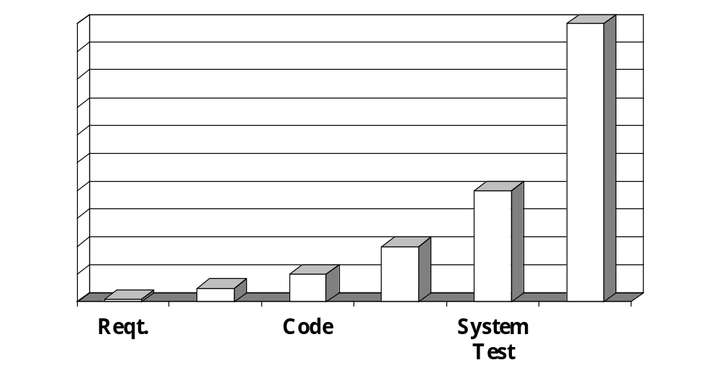
Will SQA Activities Pay Off?
Relative cost of correcting an error
40-1000 times
Errors are cheaper to fix earlier
30-70
15-40
3-6
10
1
Design
Dev.Test
Fielded

Slide 5
Elements of SQA
Standards
Reviews and Audits
Testing
Error/defect collection and analysis
Change management
Education
Vendor management
Security management
Safety
Risk management
These slides are designed to accompany Software Engineering: A Practitioner’s Approach, 7/e (McGraw-Hill 2009). Slides copyright 2009 by Roger Pressman.

Slide 6

QA Activities
Process
Definition &
Standards
Formal
Technical
Reviews
Analysis
&
Reporting
Test
Planning
& Review
Measurement

Slide 7
Role of the SQA Group-I
Prepares an SQA plan for a project.
  The plan identifies
    evaluations to be performed
    audits and reviews to be performed
    standards that are applicable to the project
    procedures for error reporting and tracking
    documents to be produced by the SQA group
    amount of feedback provided to the software project team
Participates in the development of the project’s software process description.
  The SQA group reviews the process description for compliance with organizational policy, internal software standards, externally imposed standards (e.g., ISO-9001), and other parts of the software project plan.
These slides are designed to accompany Software Engineering: A Practitioner’s Approach, 7/e (McGraw-Hill 2009). Slides copyright 2009 by Roger Pressman.

Slide 8
Role of the SQA Group-II
Reviews software engineering activities to verify compliance with the defined software process.
  identifies, documents, and tracks deviations from the process and verifies that corrections have been made.
Audits designated software work products to verify compliance with the software process.
  reviews selected work products; identifies, documents, and tracks deviations; verifies that corrections have been made
  periodically reports the results of its work to the project manager.
Ensures deviations in software work and products are documented and handled with documented procedures.
Records noncompliance and reports to senior management.
  Noncompliance items are tracked until they are resolved.
These slides are designed to accompany Software Engineering: A Practitioner’s Approach, 7/e (McGraw-Hill 2009). Slides copyright 2009 by Roger Pressman.

Slide 9
SQA Goals (see Figure 16.1)
Requirements quality. The correctness, completeness, and consistency of the requirements model will have a strong influence on the quality of all work products that follow.
Design quality. Every element of the design model should be assessed by the software team to ensure that it exhibits high quality and that the design itself conforms to requirements.
Code quality. Source code and related work products (e.g., other descriptive information) must conform to local coding standards and exhibit characteristics that will facilitate maintainability.
Quality control effectiveness. A software team should apply limited resources in a way that has the highest likelihood of achieving a high quality result.
These slides are designed to accompany Software Engineering: A Practitioner’s Approach, 7/e (McGraw-Hill 2009). Slides copyright 2009 by Roger Pressman.

Slide 10
Finding Quality Requirements
One aspect of requirements analysis.
"Analysis" implies breaking down the general requirement into smaller, more manageable requirements.
Two parts:
  (1) allocate quality requirements from upper level functions to lower level functions
  (2) break down quality requirements individual quality factors and further decompositions

Slide 11
Analyzing Quality Requirements
Quality is the totality of features and characteristics of a product or service that bear on its ability to satisfy a given need.
Quality Factors are the individual features.
  tend to be user or function oriented terms.
Different aspects of quality may in fact have little relationship to one another
  or may contradict each other

Slide 12
Sample Quality Factors
Correctness Survivability
Reliability Verifiability
Maintainability Flexibility
Interoperability Portability
Expandability Reusability
Efficiency Safety
Security Usability

Slide 13
Different Approaches to Specifying Quality
Four approaches to specifying quality requirements:
  Qualitative specification
  Design characteristics specification
  Quality criteria specification
  Quantitative specification
Notes:
Each is discussed on the following four slides
Following these is a little more detail on qualitative specification and quality criteria specification

Slide 14
1. Qualitative Specification
Qualitative terms introduced above to specify quality
For example: "The control panel function of the system shall have very high usability."
Not objectively verifiable.
Definitions of terms "very high,” etc., should also be included

Slide 15
Qualitative Characterization
Because of the way we use quality factors we want to characterize them by degree
However, precision may be unimportant to us; we just want broad ranges of degree
Consequently, we use a scheme of characterizing each quality factor as one of: very high, high, nominal, low or very low
This approach has been adapted from Barry Boehm's COCOMO software costing model

Slide 16
2. Design Characteristics Specification
Sometimes it is easier to describe the system characteristics that you want
  For example: "To improve correctness, the software shall be implemented using a strongly typed language, and all data types shall be defined with explicit ranges."
Defines the quality requirement in terms of how it will be achieved. It is fully verifiable.
Several design characteristics specifications will be necessary for each quality factor

Slide 17
3. Quality Criteria Specification
Quality criteria decompose quality factors
Many assessment techniques actually measure quality criteria
  For example: "To facilitate maintainability of the software, the cyclomatic complexity shall be no higher than 10 for any configuration entity."
Captures part of the concept of maintainability.
  is measurable

Slide 18
Quality Criteria
Quality factors tend to be user oriented or function oriented terms.
  often do not represent easily measurable or even identifiable aspects of the software
  For example, how do you measure maintainability?
Generally, try to find characteristics which are more easily measurable, and relate the quality factors to them
Discussed more in Comp 8081

Slide 19
Example Quality Criteria
Accuracy Generality
Anomaly Management Independence
Application Independence Modularity
Augmentability Operability
Autonomy Reconfigurability
Commonality Self-descriptiveness
Communicativeness Simplicity
Completeness Specificity
Conciseness System Accessibility
Consistency System Clarity
Distributedness System Compatability
Document Accessability Traceability
Effectiveness Training
Functional Overlap Virtuality
Functional Scope Visibility

Slide 20
4. Quantitative Specification
Define a metric for the quality factor
  identify a numeric value for the degree of quality that must be achieved
  For example: "The CPU efficiency of the software shall be at least 90%," where efficiency = (optimal CPU use / actual CPU use) * 100%
  Another example: "The MTBF shall be at least 10,000 operational hours to 95% confidence”
PROBLEM: not well developed for most software quality factors

Slide 21
Why Specify Quality Requirements?
Without a clear concept of 'quality' we cannot specify its requirements, or assess if the requirements have been met.
Quality has many faces and we want to be clear that the need for one factor does not necessarily imply a need for others.
Quality requirements are real and are distinct from functional requirements.

Slide 22
Statistical SQA
Product
& Process
Collect information on all defects
Find the causes of the defects
Move to provide fixes for the process
measurement
... an understanding of how
to improve quality ...
These slides are designed to accompany Software Engineering: A Practitioner’s Approach, 7/e (McGraw-Hill 2009). Slides copyright 2009 by Roger Pressman.

Slide 23
Statistical SQA
Information about software errors and defects is collected and categorized.
An attempt is made to trace each error and defect to its underlying cause (e.g., non-conformance to specifications, design error, violation of standards, poor communication with the customer).
Using the Pareto principle (80 percent of the defects can be traced to 20 percent of all possible causes), isolate the 20 percent (the vital few).
Once the vital few causes have been identified, move to correct the problems that have caused the errors and defects.
These slides are designed to accompany Software Engineering: A Practitioner’s Approach, 7/e (McGraw-Hill 2009). Slides copyright 2009 by Roger Pressman.

Slide 24
Six-Sigma for Software Engineering
The term “six sigma” is derived from six standard deviations—3.4 instances (defects) per million occurrences—implying an extremely high quality standard.
The Six Sigma methodology defines three core steps:
  Define customer requirements and deliverables and project goals via well-defined methods of customer communication
  Measure the existing process and its output to determine current quality performance (collect defect metrics)
  Analyze defect metrics and determine the vital few causes.
  Improve the process by eliminating the root causes of defects.
  Control the process to ensure that future work does not reintroduce the causes of defects.
These slides are designed to accompany Software Engineering: A Practitioner’s Approach, 7/e (McGraw-Hill 2009). Slides copyright 2009 by Roger Pressman.

Slide 25
Software Reliability
A simple measure of reliability is mean-time-between-failure (MTBF), where
MTBF = MTTF + MTTR
The acronyms MTTF and MTTR are mean-time-to-failure and mean-time-to-repair, respectively.
Software availability is the probability that a program is operating according to requirements at a given point in time and is defined as
Availability = [MTTF/(MTTF + MTTR)] x 100%
These slides are designed to accompany Software Engineering: A Practitioner’s Approach, 7/e (McGraw-Hill 2009). Slides copyright 2009 by Roger Pressman.

Slide 26
Software Safety
Software safety is a software quality assurance activity that focuses on the identification and assessment of potential hazards that may affect software negatively and cause an entire system to fail.
If hazards can be identified early in the software process, software design features can be specified that will either eliminate or control potential hazards.
These slides are designed to accompany Software Engineering: A Practitioner’s Approach, 7/e (McGraw-Hill 2009). Slides copyright 2009 by Roger Pressman.

Slide 27
ISO 9001:2008 Standard
ISO 9001:2008 is the quality assurance standard that applies to software engineering.
The standard contains requirements that must be present for an effective quality assurance system.
The requirements delineated by ISO 9001:2008 address topics such as
  management responsibility, quality system, contract review, design control, document and data control, product identification and traceability, process control, inspection and testing, corrective and preventive action, control of quality records, internal quality audits, training, servicing, and statistical techniques.
These slides are designed to accompany Software Engineering: A Practitioner’s Approach, 7/e (McGraw-Hill 2009). Slides copyright 2009 by Roger Pressman.

